Slide 1

FIGARO HOME
You don’t need to learn AI.
You need it working.
A done-for-you AI assistant for business owners, set up around one real workflow in your business.
£550 once for Figaro Home and onboarding £99 a month for the operator
FIGARO FOR OWNER LED BUSINESSES
Notes:
Open with the buyer’s job, not the technology. Figaro is configured for a real business workflow, not sold as another course or prompt library.
Sources:
- https://myfigaro.ai/
- https://myfigaro.ai/preorder

Slide 2

FIGARO
02
The work still lands back on the owner
You have seen the demos and tried the tools. The market is moving, but most products still ask you to learn prompts, connect systems and supervise another setup project.
The gap
Explain the context again
Move the answer between apps
Check whether the work is right
Finish the consequential step yourself
myfigaro.ai
Notes:
The target buyer owns the business, carries too much of the day-to-day work and does not want AI to become another project to manage.
Sources:
- https://myfigaro.ai/

Slide 3
FIGARO
03
One message becomes a completed workflow
01
02
03
04
You send a normal message
Figaro does the work
The result is ready
You make the decision
“Compare our closest competitors, tell me what changed and draft the customer follow-up.”
Checks current sources, records the links, writes the brief and prepares the email.
You receive the competitor brief and the customer email draft in the same job.
Review the draft before anything is sent to the customer.
FIGARO PREPARES
YOU APPROVE
myfigaro.ai
Notes:
Use this workflow as the plain-language product explanation. The operating rule is simple: Figaro prepares the work and the owner approves the consequential step.
Sources:
- https://myfigaro.ai/

Slide 4
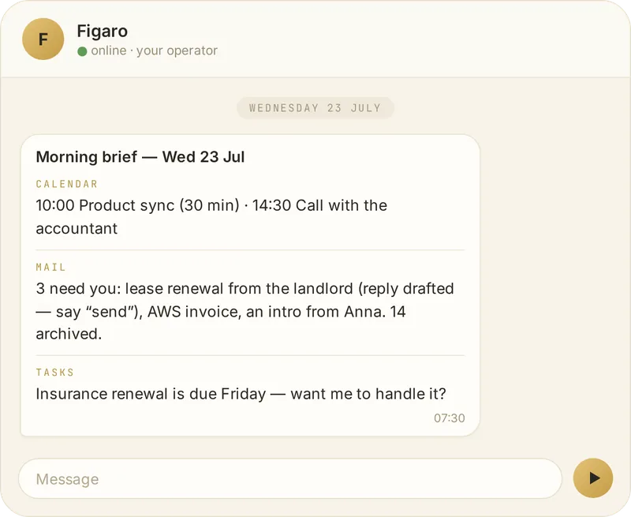
FIGARO
04
A working day with Figaro
08:30
Start with a short brief
Calendar, important messages and open work in one view
10:15
Send one real job
A competitor check, meeting follow-up or first draft
15:40
Get the result and evidence
What Figaro did, what it found and what still needs you
17:45
Approve the consequential step
Sending, publishing, spending and merging stay with you
myfigaro.ai
Notes:
The day is illustrative. Keep the focus on completed work and decision points.
Sources:
- https://myfigaro.ai/

Slide 5
FIGARO
05
Start with the jobs that cost attention
Research and follow-up
Product and code
A sourced competitor brief with a customer email draft
A tested change ready for review before anything merges
Meetings and documents
Phone workflows
Notes, decisions, next steps and an updated document
A prepared booking or call that runs after approval
Inbox and calendar
Content and growth
A morning summary, prepared replies and the day’s blockers
A draft, creative or campaign prepared for review
Begin with one agreed workflow. Expand only after it works reliably.
myfigaro.ai
Notes:
These are proven categories on the reference deployment. A client commitment begins with the workflow confirmed during onboarding.
Sources:
- https://www.myfigaro.ai/how-it-works

Slide 6
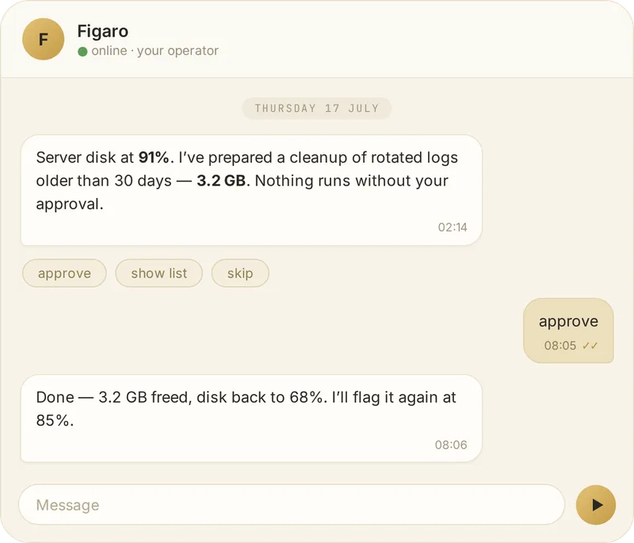
FIGARO
06
Consequential actions wait for your tap
Figaro can prepare
You approve
Read
Research
Draft
Plan
Build in a sandbox
Send
Publish
Spend
Merge
Call
Every job leaves a receipt of what happened.
myfigaro.ai
Notes:
The approval boundary is the buyer’s control surface. Reading and preparation can run automatically; consequential actions remain with the owner.
Sources:
- https://www.myfigaro.ai/how-it-works

Slide 7
FIGARO
07
Useful context carries forward
Figaro keeps the operating context that a chat window usually drops
Projects and people
Rules and preferences
The work, the relationships and the commitments around it
How you want the business to operate and communicate
Corrections and outcomes
Recorded receipts
What you accepted, rejected or changed
What ran, what it produced and what required your decision
myfigaro.ai
Notes:
Avoid promising perfect memory. The benefit is operational continuity: less re-explaining, clearer handoffs and decisions that remain attached to their context.
Sources:
- https://www.myfigaro.ai/how-it-works

Slide 8

FIGARO
08
A dedicated place for Figaro to run
Figaro Home stays on in your home or office and gives the operator a stable place to work around the clock.
01
Chat history, files, memory and connector tokens stay on the machine
02
Model calls go to Anthropic under your own API key
03
The box needs power, internet and the model connection
04
Provisioning, updates and support come with Figaro
myfigaro.ai
Notes:
The hardware claim is specific: local working files and credentials, with model calls sent to Anthropic on the customer’s own API key. The product is not offline.
Sources:
- https://www.myfigaro.ai/how-it-works
- https://www.myfigaro.ai/preorder

Slide 9
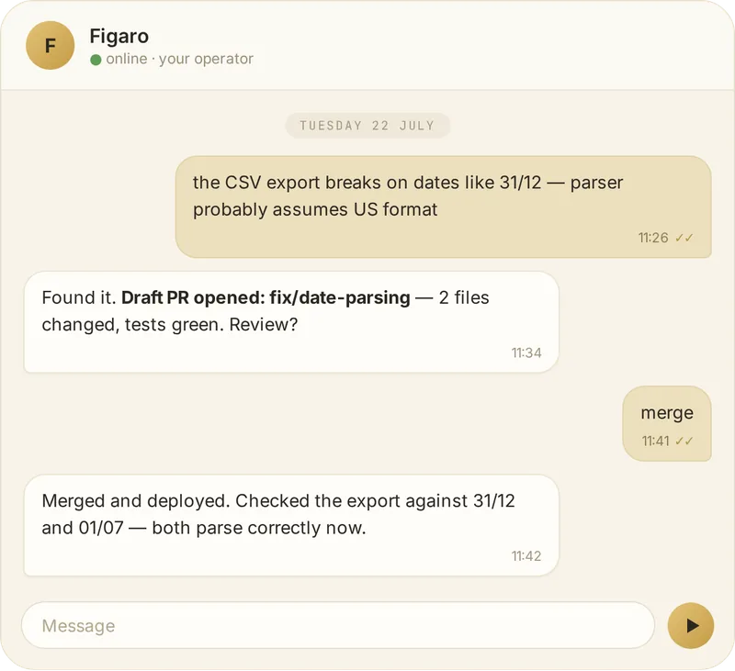
FIGARO
09
Proof from the reference deployment
29 August to 23 September 2026
1,212
900
1
pull requests merged
opened by Figaro coding workers
revert in the period
This is proof of the operating model, not a performance guarantee for every client workflow.
myfigaro.ai
Notes:
Present the dated receipt exactly. Do not convert the reference deployment’s historical result into a customer promise.
Sources:
- https://www.myfigaro.ai/how-it-works

Slide 10
FIGARO
10
Onboarding begins with one real job
01
Choose the workflow
Name the job and define what finished means
02
Connect only what it needs
Start with the smallest useful set of accounts and tools
03
Agree the approval boundary
Decide what can run and what must wait for your tap
04
Run and review
Check the receipt, fix the workflow, then expand when it is reliable
The setup call should end with a clear scope and something useful already moving.
myfigaro.ai
Notes:
The client deployment starts narrower than the reference deployment. Use onboarding to make the first workflow, approval policy and live integrations explicit.
Sources:
- https://myfigaro.ai/

Slide 11
FIGARO
11
Where Figaro fits
 | Chat model | DIY agent runtime | Figaro
Primary job | Answer a question | Build and run agents | Finish repeatable business workflows
Who configures it | The user | A technical owner or team | Set up with you and maintained by Figaro
Context and evidence | Session or project context | Configurable | Operational context, approval steps and receipts
Best fit | One-off thinking | Teams willing to maintain the stack | Owner-led businesses that want a managed setup
Figaro adds the operating layer around strong models and connected tools.
myfigaro.ai
Notes:
Keep the comparison neutral. Figaro is not a replacement for strong models. It is the managed operating layer that keeps context, coordinates tools and returns reviewable work.
Sources:
- https://www.myfigaro.ai/how-it-works

Slide 12
FIGARO
12
Price and running cost
£550
£99
once
a month
Figaro Home
Delivery included
White-glove onboarding
Operator software
Updates and support
Works on your own Anthropic API key
Anthropic bills model usage separately. A £20 refundable reservation is available. The delivery window is confirmed before a reservation balance is due.
myfigaro.ai
Notes:
State all running costs together. The £550 purchase and £99 monthly operator fee do not include Anthropic’s metered model usage.
Sources:
- https://myfigaro.ai/preorder
- https://myfigaro.ai/

Slide 13
FIGARO
13
Built from an owner’s own bottleneck
When every decision and follow-up returns to the owner, growth creates more coordination instead of more leverage.
Figaro is built around that bottleneck: completed work, a visible receipt and owner approval where judgment matters.
The product runs on the same reference deployment that builds Figaro and its go-to-market material.
myfigaro.ai
Notes:
Use the founder story to explain why Figaro focuses on owner accountability and finished work. Avoid unsupported biography or market claims.
Sources:
- https://www.myfigaro.ai/how-it-works

Slide 14

Choose the first job you want gone
Tell us what keeps following you into the evening. We will map the first Figaro workflow around it and say plainly what can run now.
myfigaro.ai
£550 once £99 a month model usage billed separately
Notes:
Close on the first workflow, not on a broad transformation promise. The next useful step is a short conversation about one recurring job.
Sources:
- https://myfigaro.ai/

